Slide 1
Hello Everyone!
We are here to present our mini project which is →

Slide 2
STUDENT INFORMATION SYSTEM (SIS)

Slide 3

Team Members
Saurabh Upadhayay
(1900520130045)
Gaurav Pratap Singh
(2000520139002)
Anand Singh Yadav
(1900520130011)
Adarsh Tiwari
(1900520130004)
Soumya Chaudhary
(1900520130053)
Rishu Singh
(1900520130044)

Slide 4
Introduction
The project aims to build a Windows(GUI) Based application to store and manage student information.
The aim of the project is to provide effective tools to maintain the student information system (SIS).
After analysing the requirements at its premises concerning to adding student information ,updating student information , deleting student information and viewing student information.
It also provides with advanced search facilities and facilities to create authorised users with passwords.

Slide 5
Objective
The objective of student Information System is to allow the administrator to edit and find out the personal details of a student and allows the student to keep up to date his profile. It will also facilitate keeping all the records of students , such as their id, name, resident address ,phone no. etc. So all the informations about an student will be available in a few seconds.

Slide 6
Features
The Student Information system empowers you to :
Manage Student Information efficiently.
Record Student details like name, roll-no ,course , stream, year , address , phone no. ,batch etc.
Add, Update & Delete Students information easily.
Manage your own security by providing authorised user name & passwords.

Slide 7
Hardware and software requirement
HARDWARE :
Dual core processor.
128 MB Ram , 40 GB ROM.
Keyboard .
Mouse.
Windows xp/7/10 will be preferred OS.
Wamp/Xampp Server.
JDK Kit.
Apache Netbeans IDE.
SOFTWARE :

Slide 8










The student Information system has been modularised into following modules:
MODULES :-
LOGIN
REGISTRATION
SHOW INFORMATION
BATCH
COURSE
MAIN ADMIN
NEW USER
MAIN USER
DELETE
UPDATE

Slide 9

Frontend
Language
Used :

Slide 10

Backend
Language
Used :

Slide 11

DataBase Technology
Used :

Slide 12
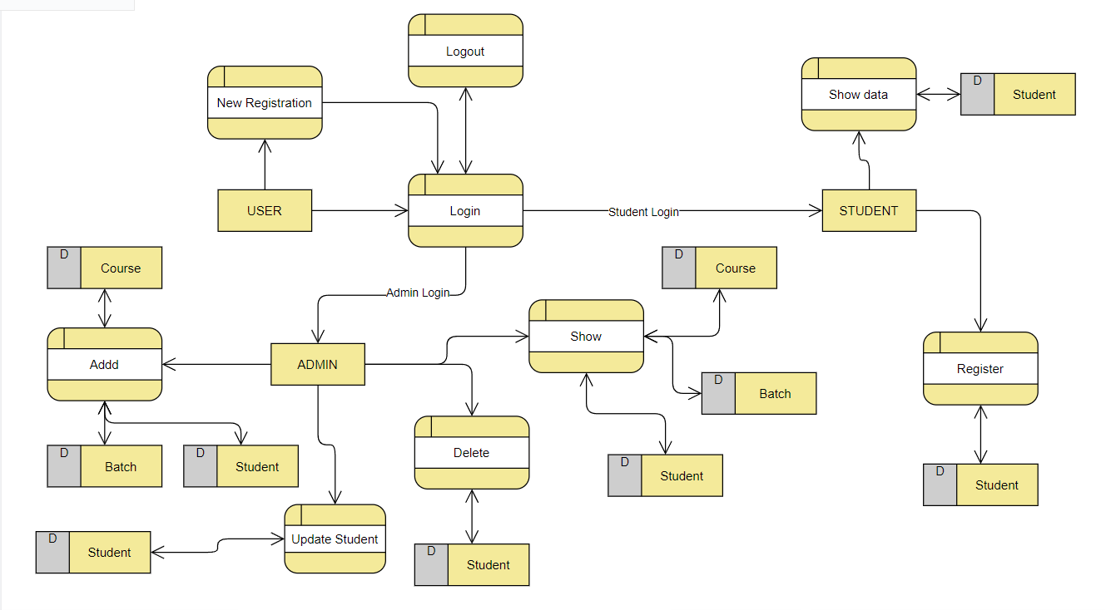
data flow diagram (DFD)

Slide 13
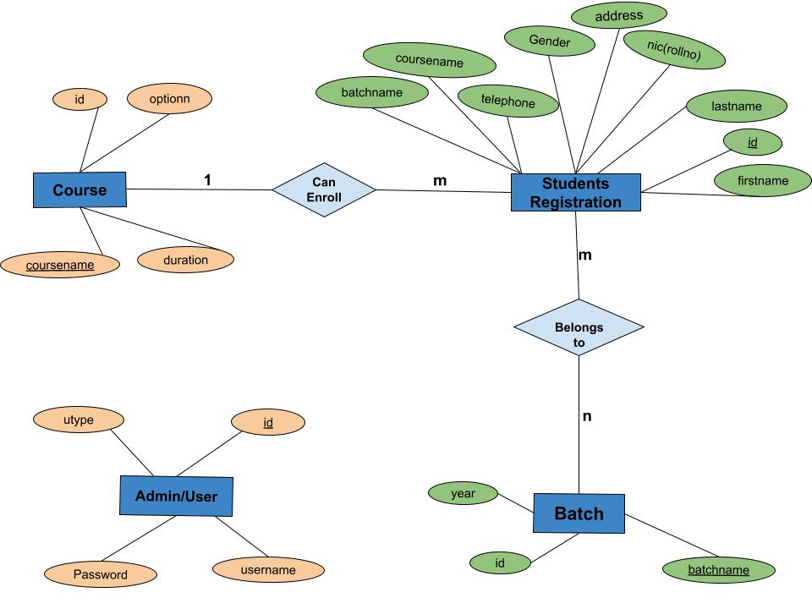
E-r diagram (paper-pen)

Slide 14
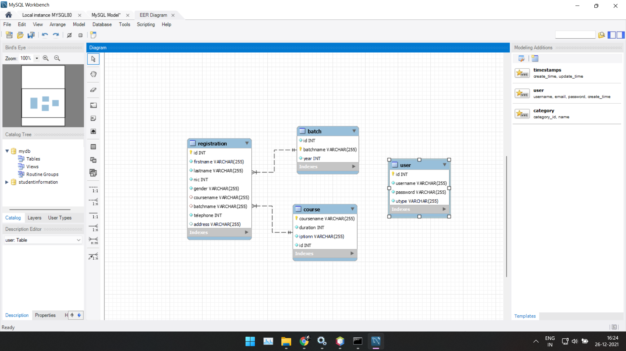
E-R Diagram (SQL workbench)

Slide 15
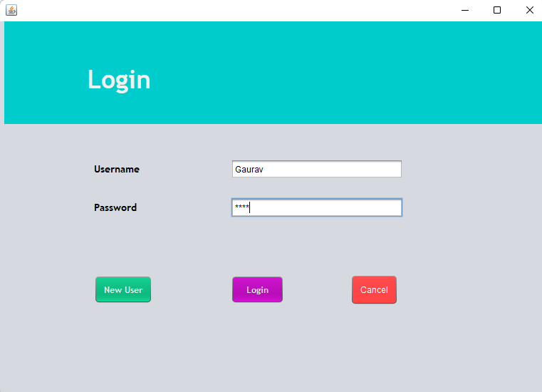
Login Portal
1
User Login Portal for users.
Requires Username & Password.
Student and Admin have different view of the database.
If the User is New to the portal then firstly the User has to register as a New User by clicking on New User.

Slide 16
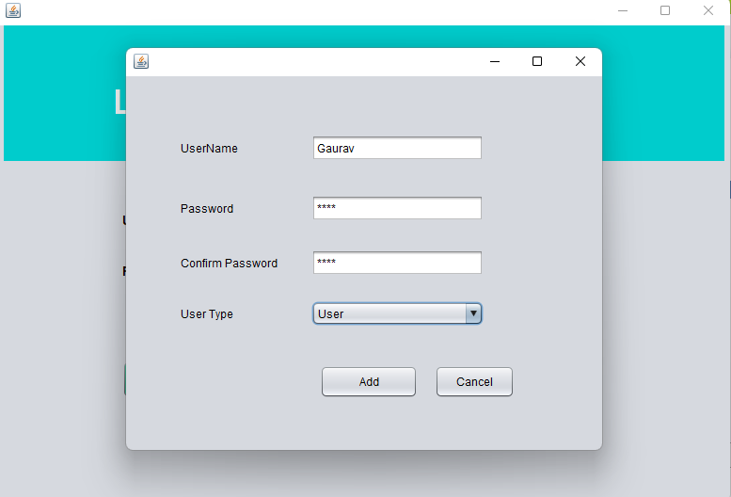
New User Signup
2
This is a New User interface here the user has to fill the following fields for Login in the system.

Slide 17
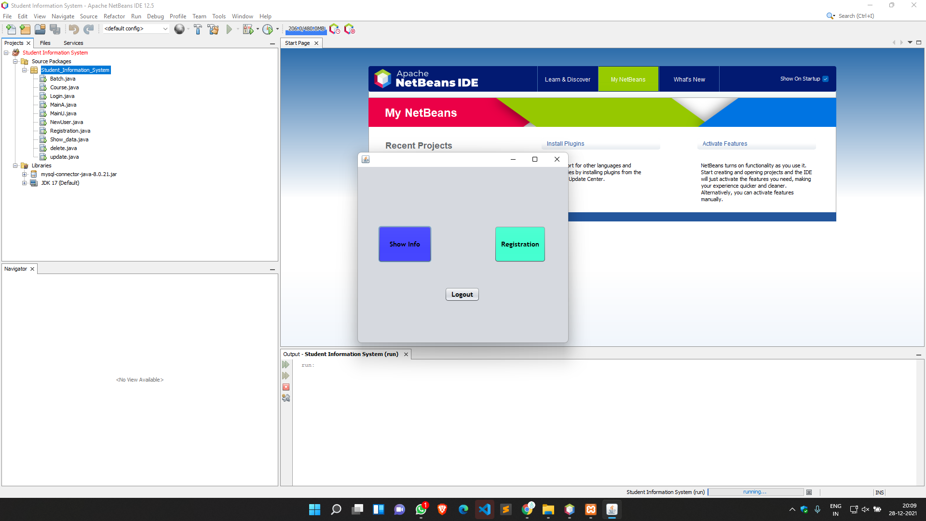
Students VIEW
3
If user Logged in as STUDENT.
STUDENT can view his details and do their Registration.

Slide 18
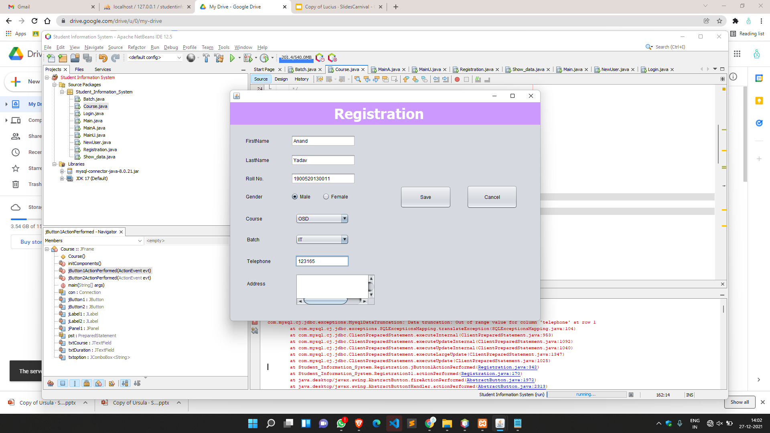
Students VIEW
4
This is a Registration Portal for STUDENTS.
STUDENTS need to fill required details to register itself.

Slide 19

Students VIEW
5
Message dialog box popups after successful registration of STUDENT when the user clicks on save button.

Slide 20
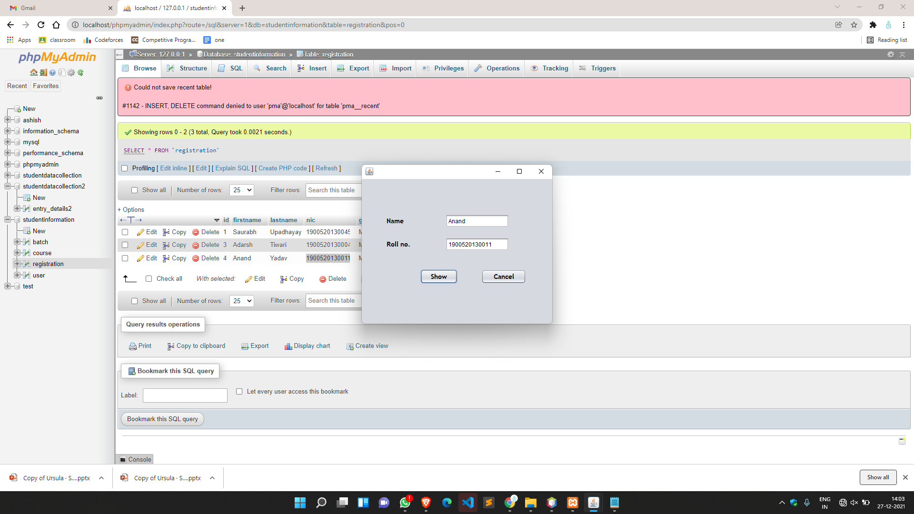
Students VIEW
5
If STUDENT choose ‘show info’ they need to fill name and roll no. to view their saved details.

Slide 21
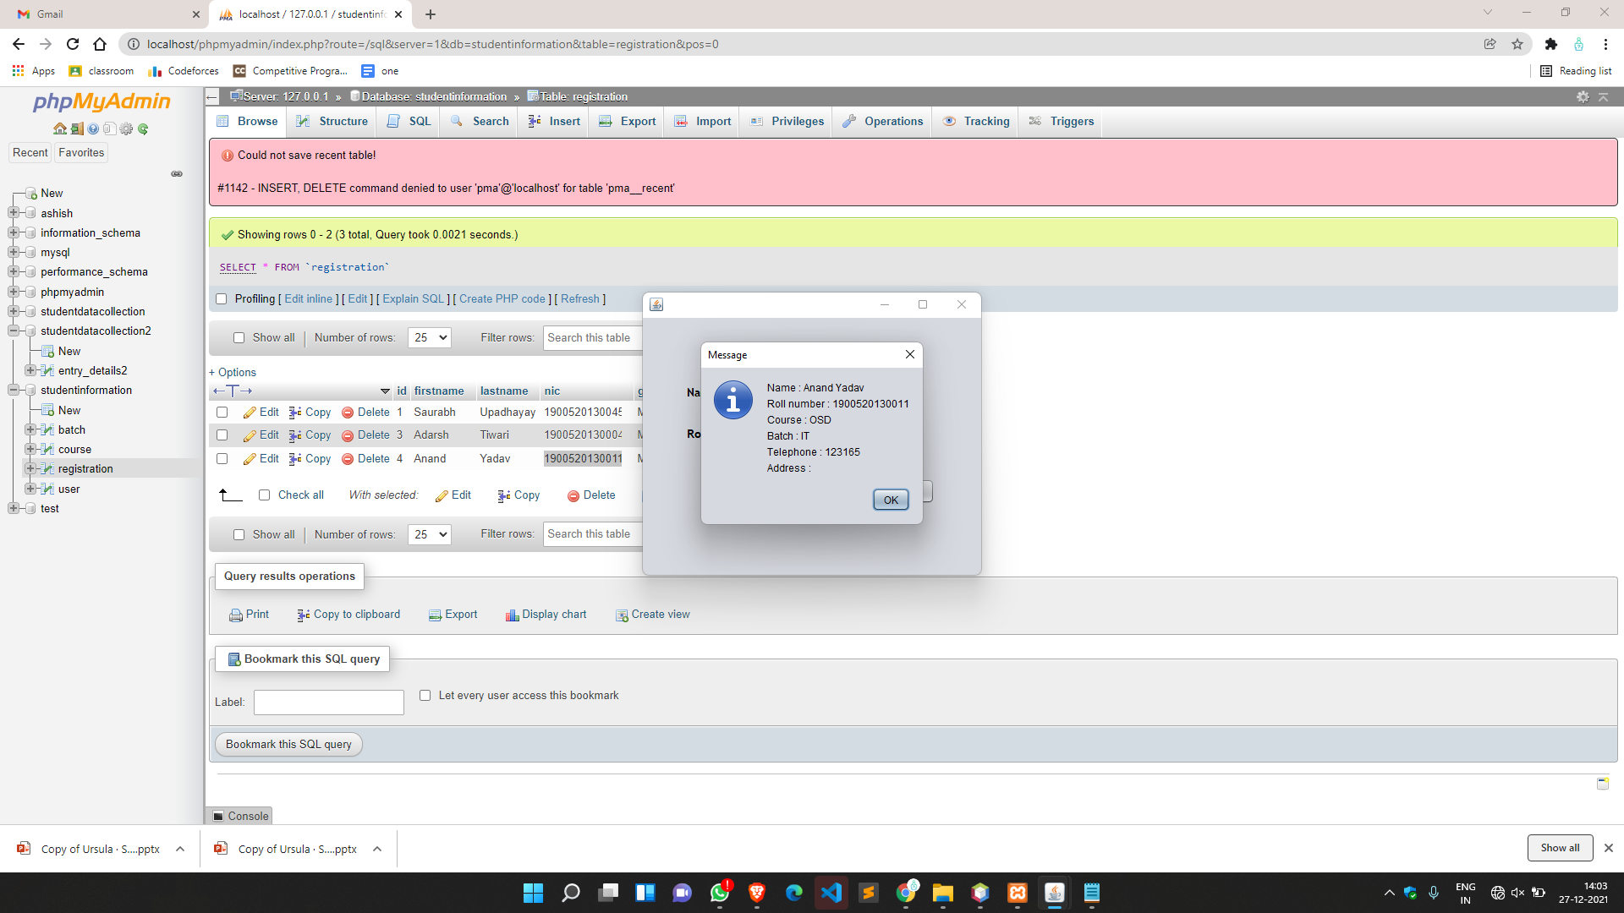
Students VIEW
6
Message popups with STUDENTS info.

Slide 22
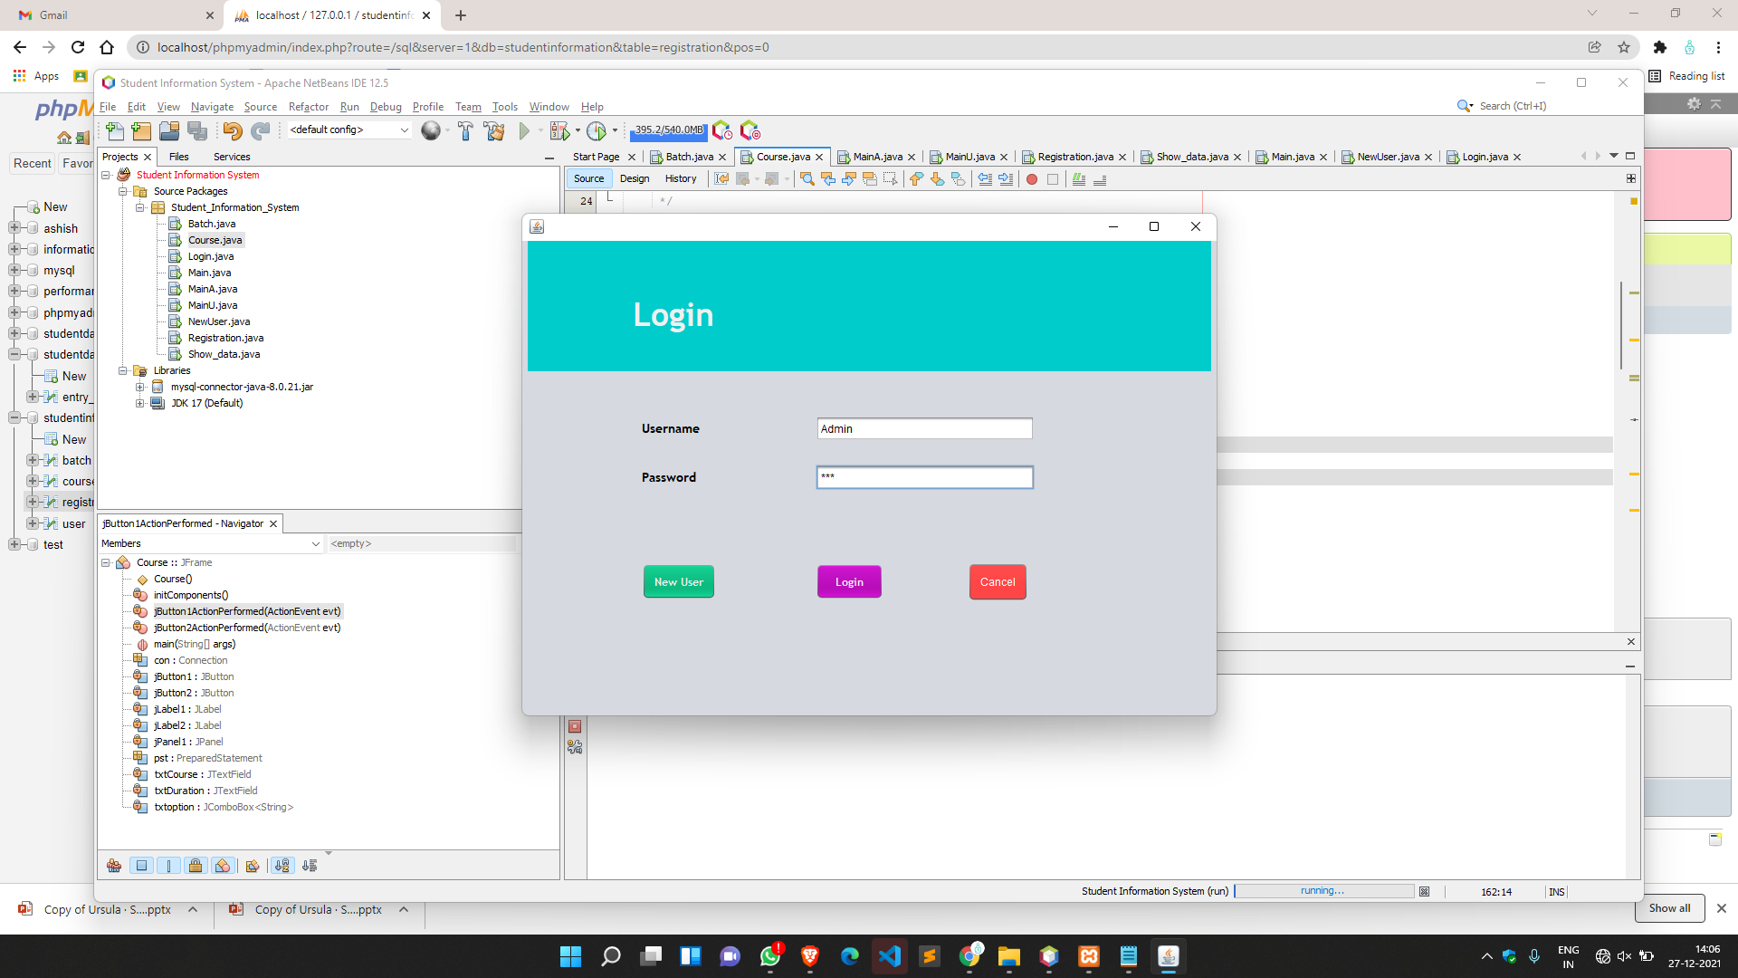
Login Portal
8
User Login portal.
If user login as Admin.

Slide 23
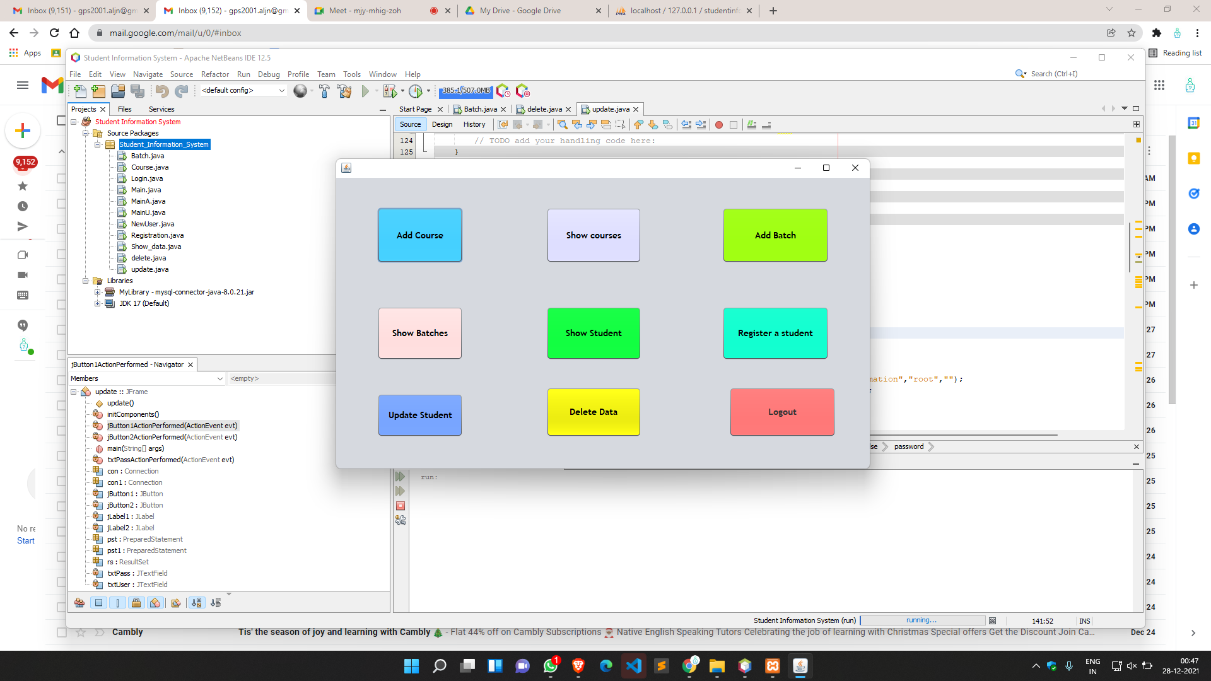
Admin’s VIEW
9
Admin view when user logged in as Admin.
Admin can perform the following actions.

Slide 24
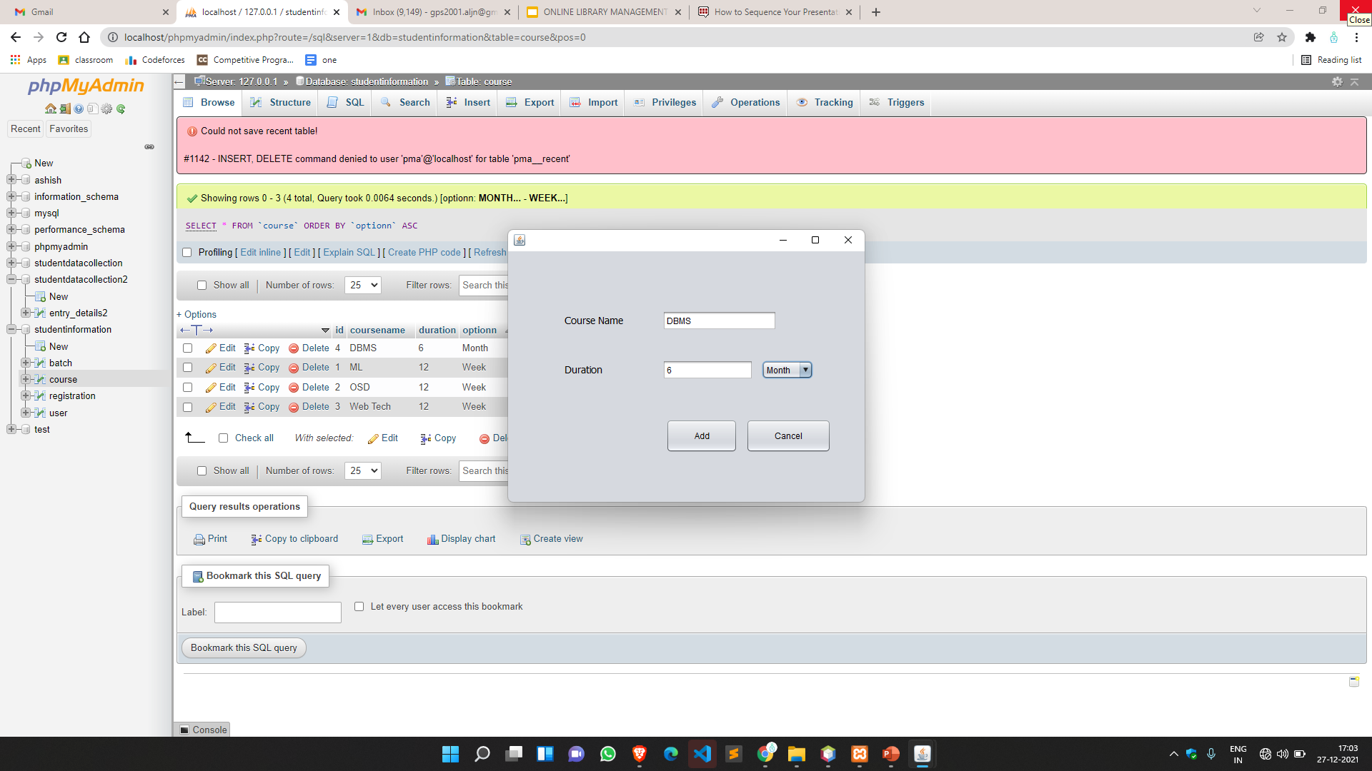
Admin’s VIEW
10
Adding a course .
Requires Course name and Duration in months/weeks .

Slide 25
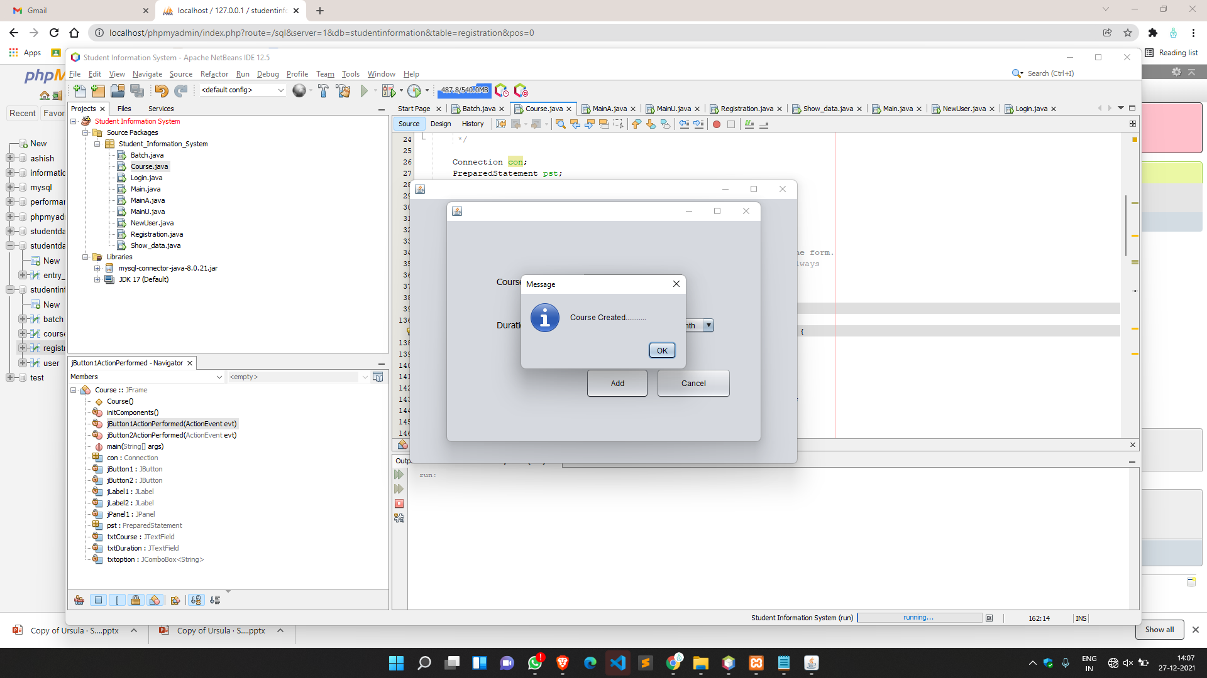
Admin’s VIEW
11
Course added successfully.

Slide 26
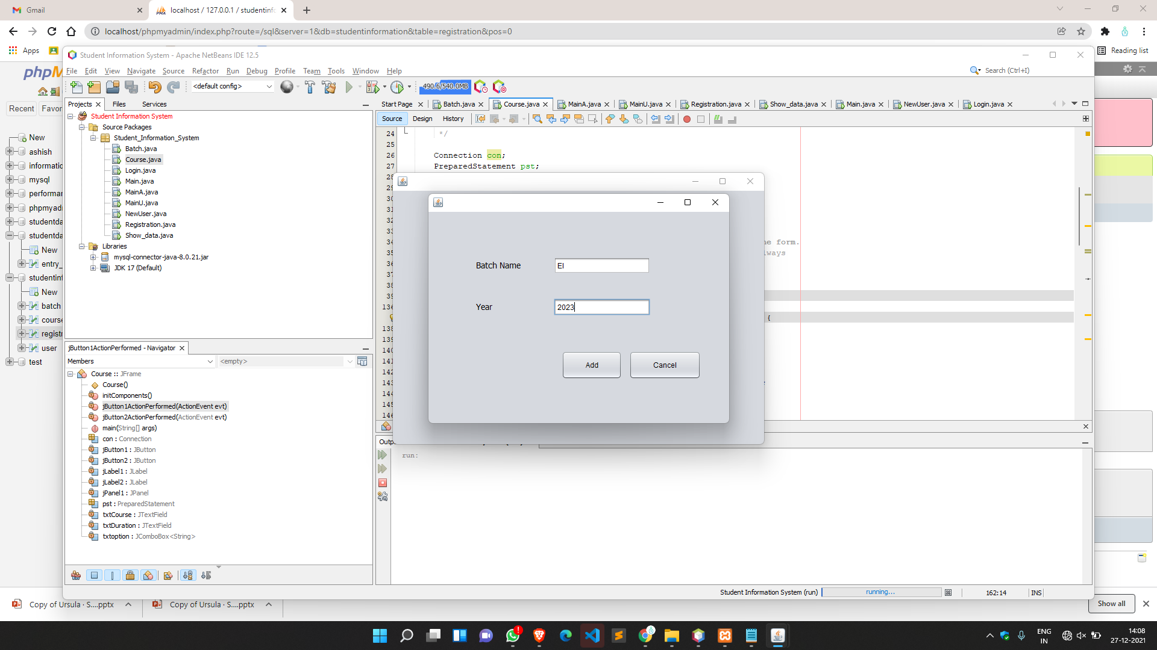
Admin’s VIEW
12
Add a new Batch.
Requires name of Batch & year of start.

Slide 27
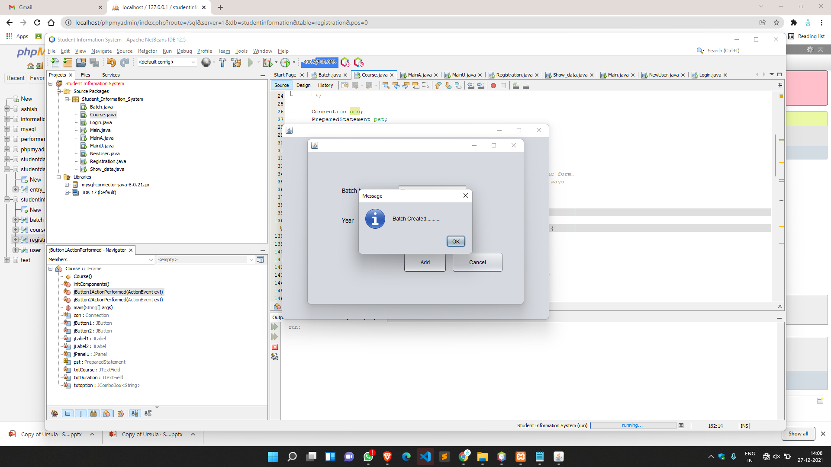
Admin’s VIEW
13
Batch Added successfully.

Slide 28
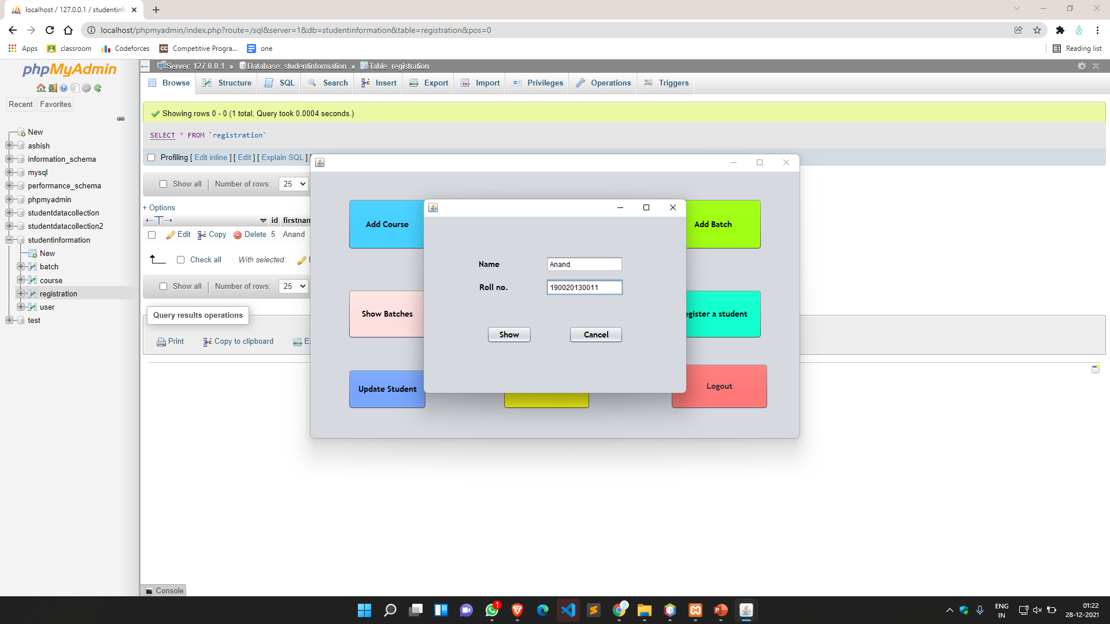
Admin’s VIEW
14
Admin can check if a student exist or not.
If student exist popup message will show the details of student.

Slide 29
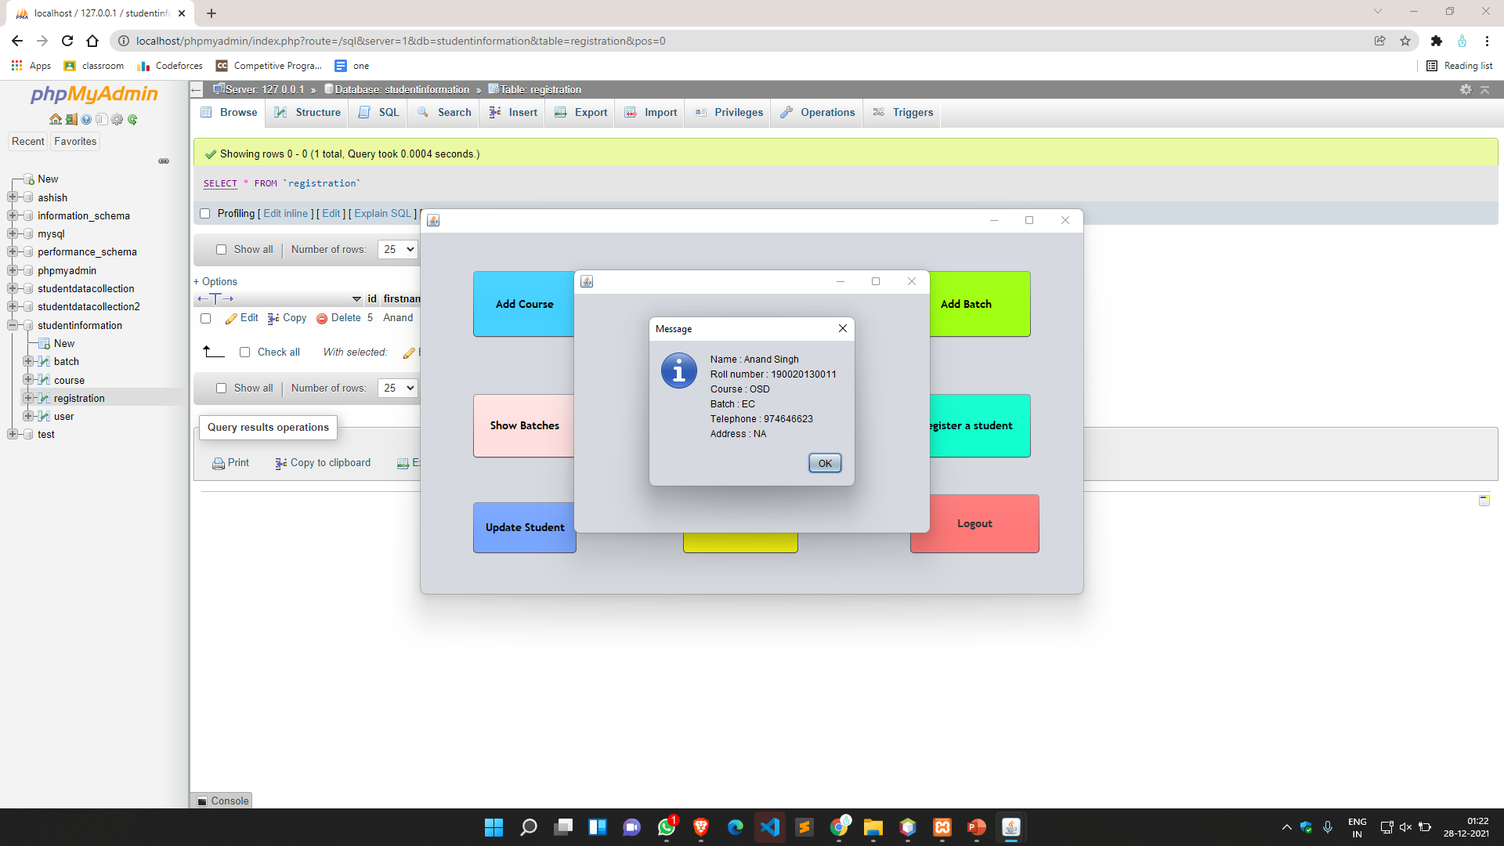
Admin’s VIEW
15
STUDENT exist.
Message dialog box popups with the student details.

Slide 30
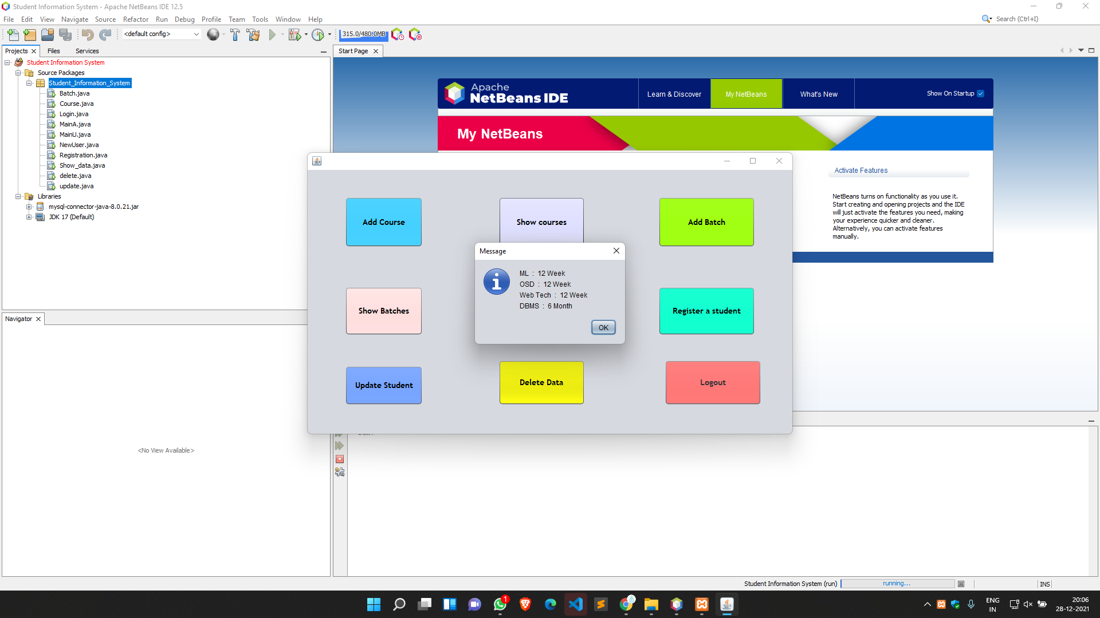
Admin’s VIEW
16
Admin can view all the registered COURSES.

Slide 31

Admin’s VIEW
17
Admin can view all registered BATCHES.

Slide 32
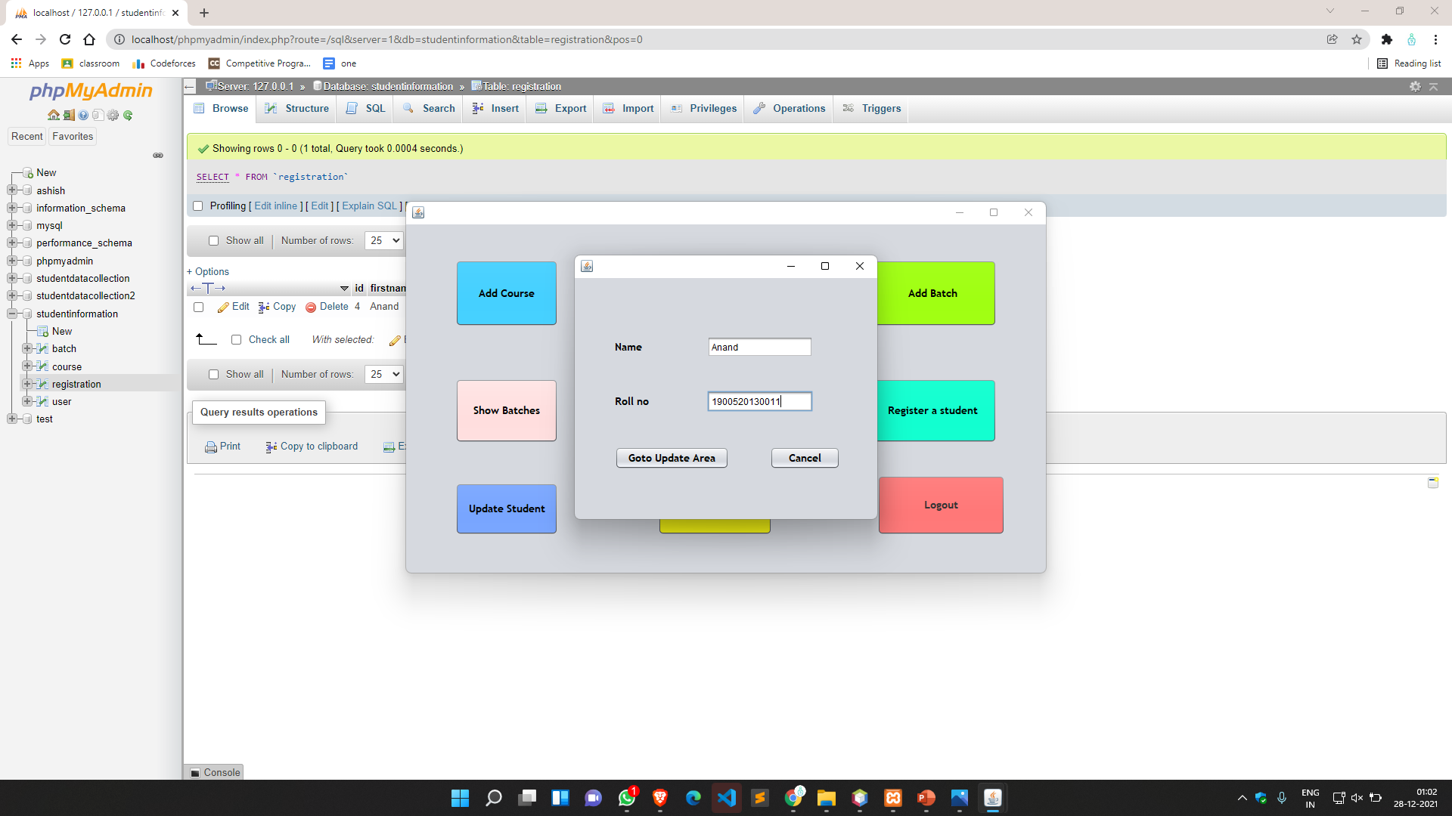
Admin’s VIEW
18
Admin can update student details.
All he need to enter name and roll number.

Slide 33
Admin’s VIEW
19
Admins view to update a student’s details.

Slide 34
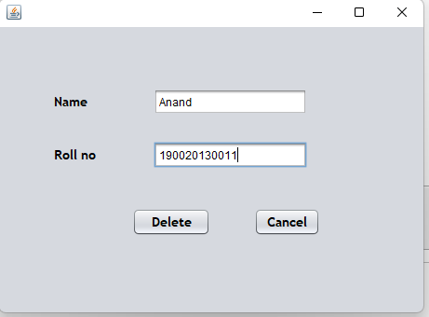
Admin’s VIEW
20
Deletion of student via Admin.
Admin need to enter name and roll no.

Slide 35
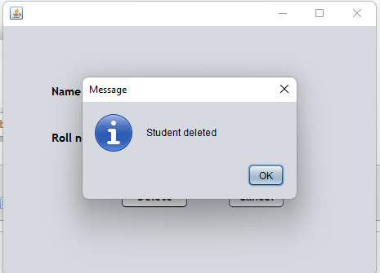
Admin’s VIEW
21
Message popups after student got deleted
by admin.

Slide 36
Future Work
We can further implement some features like :
Forgot password feature can be add by adding some security questions at the time of Signup of user & admin , so that we provide the user old password by fetching the information from database.
Delete Course/Batch feature can be add so that in future if the courses been update/delete by the organization can be easily updated.

Slide 37
Conclusion
We think that our project has almost all features that are required for a Student Information System .
Also, we think that the user interface that we provided is quite user friendly and simple .
The implementation of the system will reduce the data entry time .
Overall, it’ll make Student Information System an easier job for the administrator and the student of any organization. The main purpose of SRS document is to illustrate the requirements of the project Student Information System and is intended to help any organization to maintain and manage its student personal data.

Slide 38
Thank y u

